Slide 1
The Impact of Customer Behavior
By: Sidney Andreano
Last Updated: May 13th, 2024

Slide 2
Table of Contents
Purpose of the Analysis (what is the purpose of the analysis?)
Key Concepts of the Analysis (What are we talking about?)
Categorical Insights (What type of products sell more then others?)
Behavioral Insights (What factors of our business do customers seem to enjoy?)
Conclusion/Recommendations
Behavioral Impacts (What factors of our business do customers seem to dislike?)

Slide 3
So, What is the purpose of this analysis?

Slide 4

The Business Task
To gain valuable insights on POS data (point-of-sale) to forecast future product purchases that will be optimal for improving business performance.

Slide 5
Now, What are the Key Concepts of this Analysis?

Slide 6

We will look at….
Categorical Insights
• Product category code (Prod_Cat_Code) – An index number used to demonstrate what department an item is from
• Product sub-category code (Prod_Subcat_Code) – An index number used to demonstrate what sub-department an item is from
• What products do customers seem to buy the most? From what department?

Slide 7
Then…
Behavioral Insight
• Store Type: Types of store environments
E-Shop – e-commerce transactions from our website
TeleShop – over-the-phone transactions
Flagship Store – transactions from our largest location (face-to-face)
MBR (Multi-Base Retail) – transactions from our other locations (face-to-face)
• What store environments do customers seem to enjoy? Where do customers buy from the most?

Slide 8
And finally….
Behavioral Impacts
• Three Major Questions
How many orders were returned from customers?
How much profit was lost due to those returned orders?
What specific products are being returned?
… Four Major Questions
• How can we ensure less returns in the future?

Slide 9
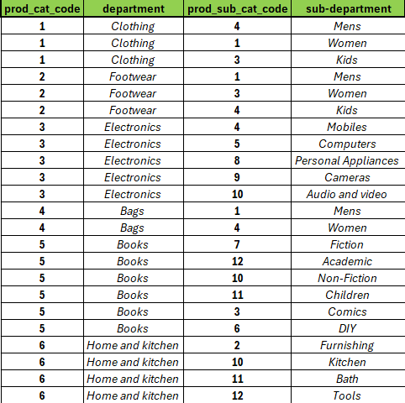
Cat_Code Reference Table

Slide 10
Let us look into the Categorical Insights.

Slide 11

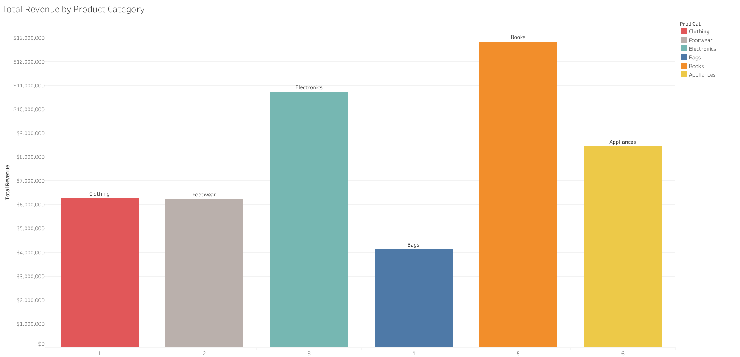
1st
$12,822,694
Total revenue
($)
2nd
$10,722,464
3rd
$8,438,993
$6,251,137
$6,219,774
Product Category Code
$4,124,709

Slide 12
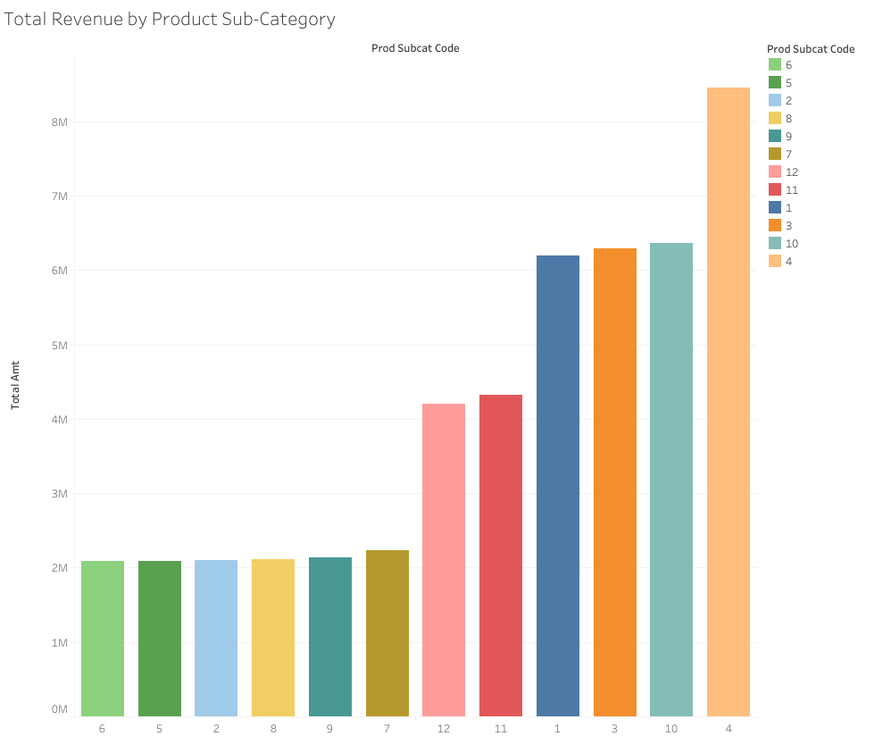
1st
$8,451,811
2nd
3rd
$6,360,968
$6,296,891
$6,196,469
$4,318,677
These Codes are in increasing order
Product Sub-Category Code
$4,205,227
≈$2,100,000

Slide 13







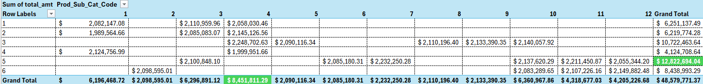
What do we Find from these Graphs and the Data?
We made 48 million dollars profit in 3 years!!
Mobile Phones are the most profitable standalone product!
Books are our top seller!
Notes:
Could add negative findings

Slide 14
Let's then investigate the Behavioral Insights.

Slide 15

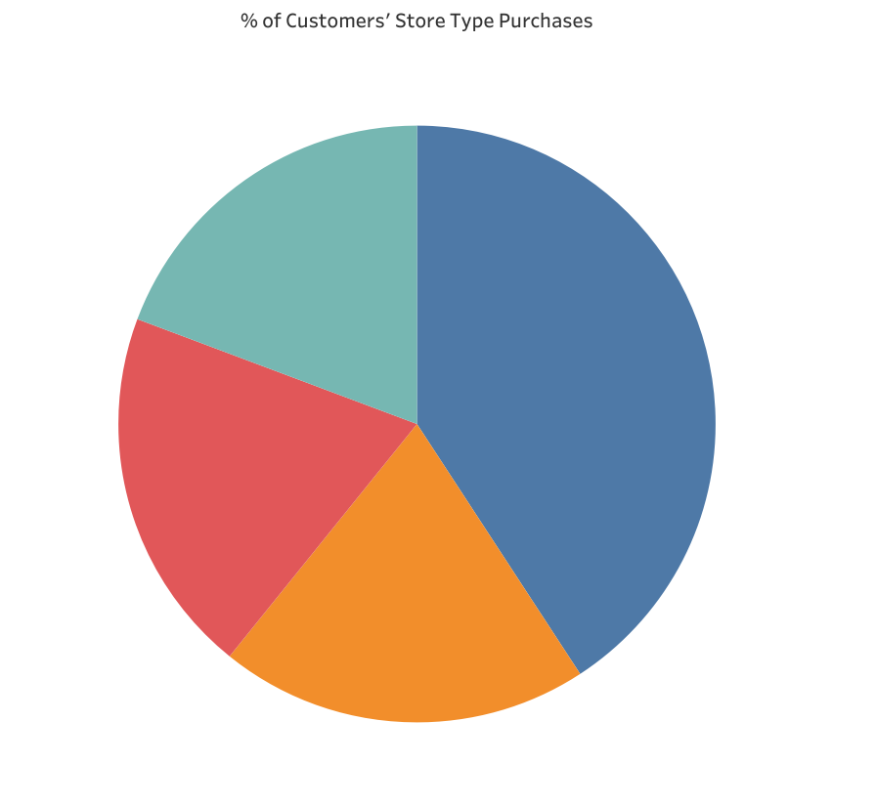
TeleShop
(18%)
E-Shop
(41%)
MBR
(19%)
Flagship Store
(20%)

Slide 16
Finally, we will explore the Behavioral Impacts.

Slide 17

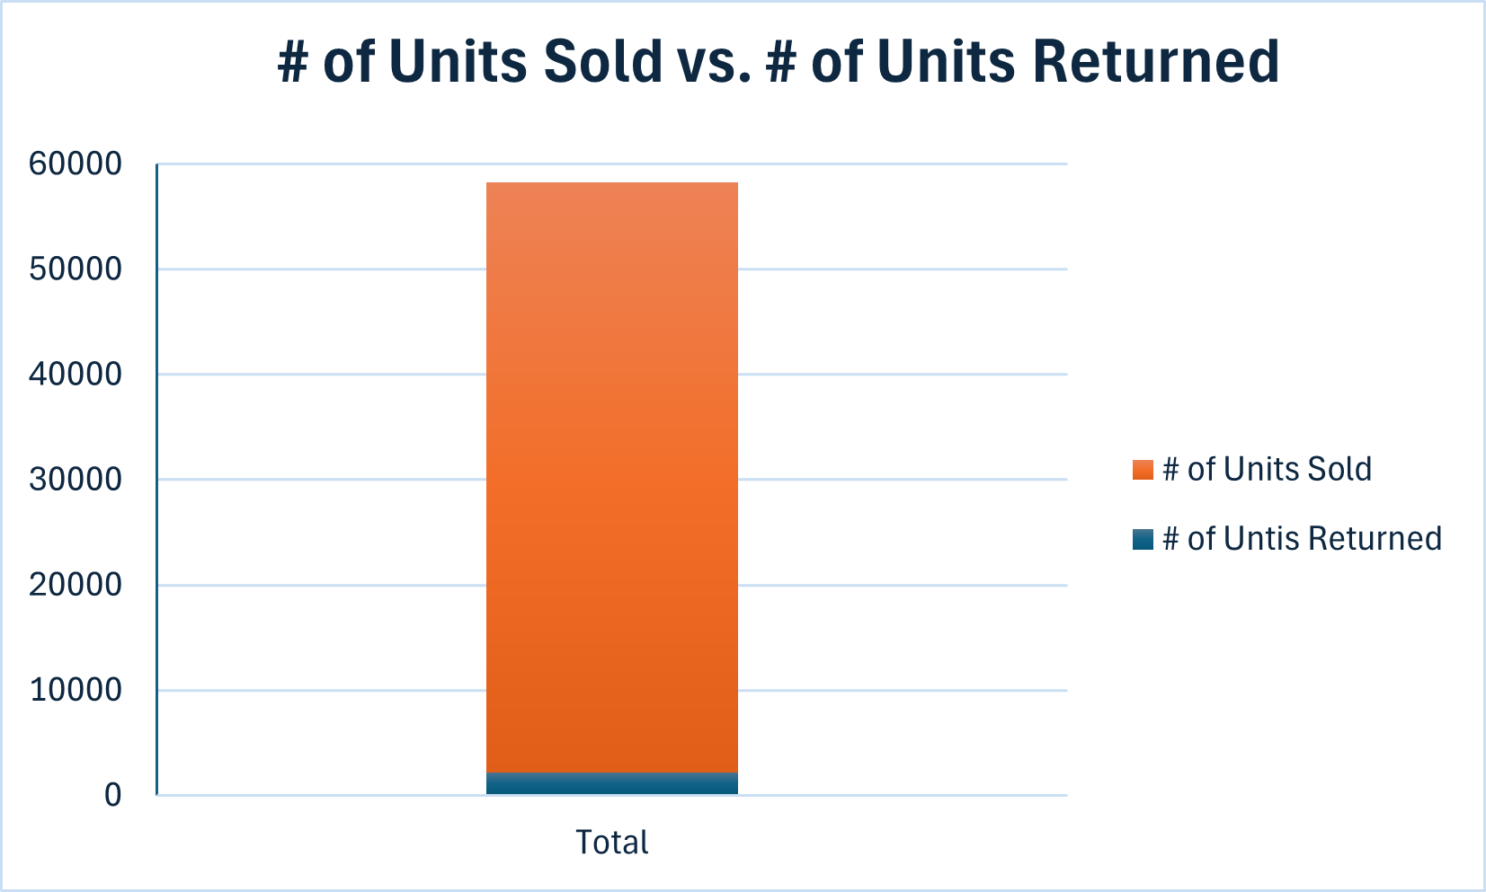
# of Total Units Sold
2,177 returned purchases = 4% of the units sold were returned
4% =
$1,684,904 Profit Loss!!!

Slide 18
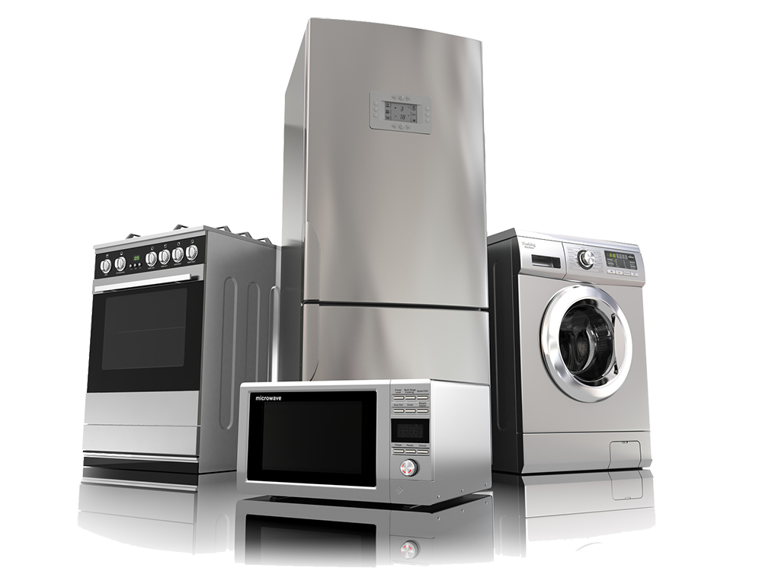
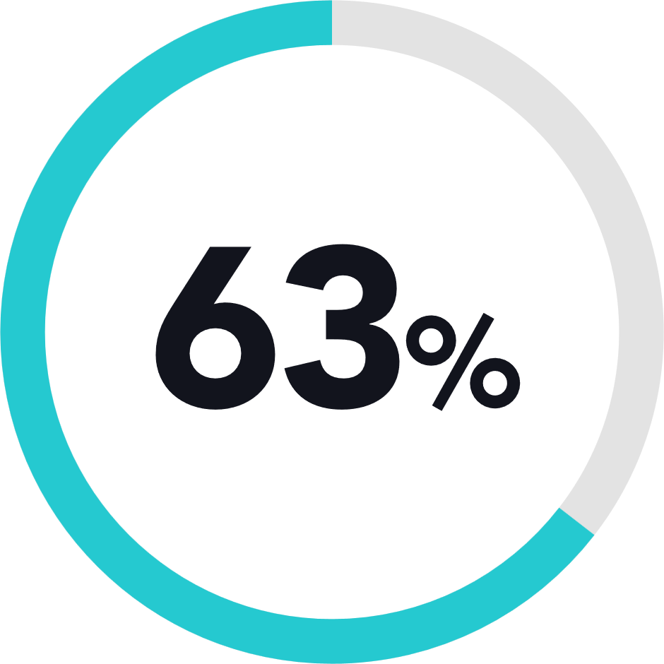

So, what product is being returned? What is causing a 4% profit loss?
of all returns
$1,053,967
Appliances

Slide 19
Conclusion/Recommendations

Slide 20

Conclusion
Customers run our company just as much as we do, and it is very important to understand their behavior. Due to the findings, we as a company can improve our services for our customers by developing more in areas that customers primarily enjoy.

Slide 21
Recommendations
1
2
3
Roughly 50% of all customers have ordered books and electronics in the last 3 years. For the future, any purchase of a book should have a survey included that can record what genre, author, and book version customers prefer. With this, future book orders can be more optimized towards what customers currently enjoy.
As shown, 41% of customers buy our products in our E-shop environment. For the future, to attract new users to our E-shop website, introduce simple user interfaces. This can include a guide page, an AI chat assistant, or an IT/Customer Service Call/Chat Service. This can also improve current E-shop customers’ experiences.
Finally, Appliances are a large liability due to the amount of customers returning appliances back to the store. For the future, customers should report their concerns of the product. This way, we can test any prior concerns in future sales in appliances.

Slide 22

Background Research & References
Github Repository
• Includes all deliverables (Scope-of-Work, Data Source document, and Data documentation)
• Includes all SQL research code
• Includes all source csv files
• Includes original case study source from AnalytixLabs.co

